Slide 2

“Stand on the left side of your screen. Your audience will anchor on you, then read across, then come back to you.” (Lynell Burmark, Ph.D.)

Slide 3
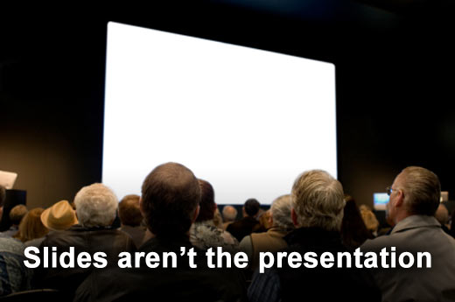
Slides shouldn’t say everything you will.

Slide 4

A presentation is not the same as a publication, so you should avoid wordy sentences on your slides. Instead, use bullet points to summarize your presentation points.

Slide 5

Increase audience member retention by as much as 30 percent by showing a slide for 14 to 21 seconds before you talking about it.

Slide 6

Spend a maximum of 40 to 90 seconds on a single slide. The optimal pacing for slides is two to three per minute. The following is a guideline for slides based on the length of your presentation.
Length of presentation | Minimum slides | Optimum slides
30 minutes | 20 slides | 60-90 slides
60 minutes | 45 slides | 150-180 slides
2 hours | 90 slides | 300-460 slides

Slide 7

The average audience member has an attention span of approximately 18 minutes. Increase the effectiveness of your presentation by providing mental stopping and starting points that reengage your audience. A good way to do this is with humor. Work in a visual “commercial break” that relates to your content at least every 15 minutes.

Slide 8

Engage the audience every three to four minutes by asking a question, helping make a connection or taking a poll. Make sure to build in time for discussion, as well.

Slide 9

The brain likes color and sees yellow first. Color visuals increase audience member willingness to read by up to 80 percent and improve retention by more than 75 percent. “77 percent perceive that presentations that use color are able to communicate better than those that use black and white.” (3M)

